Slide 1
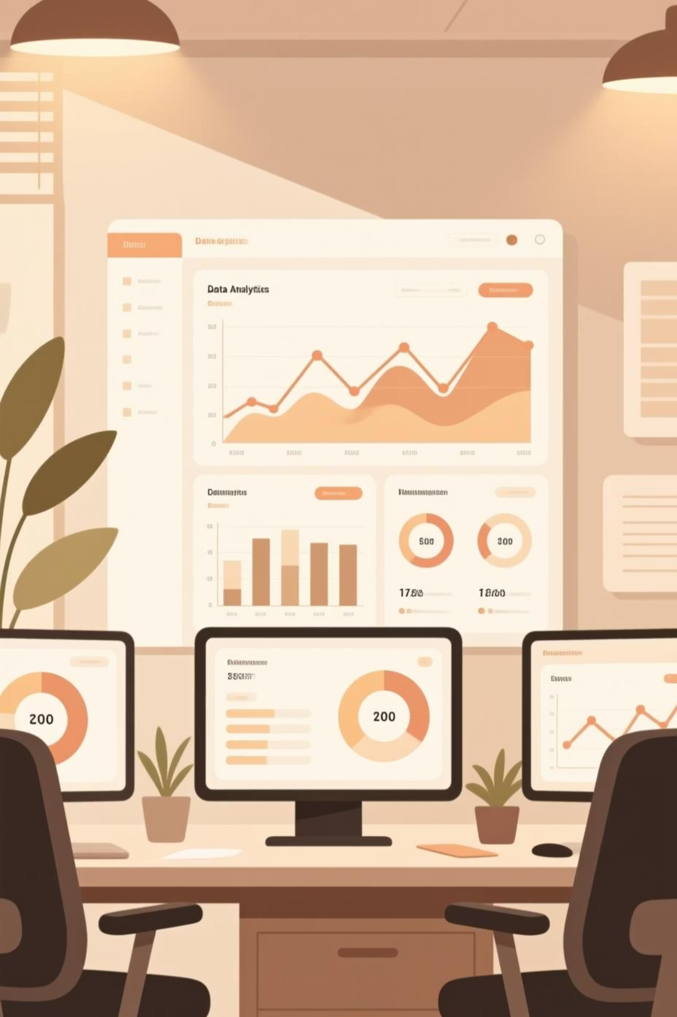
Customer Shopping Behavior Analysis
Uncovering actionable insights from 3,900 customers through data-driven analysis

Slide 2
Project Overview
End-to-end data analytics workflow combining Python, SQL, and Power BI to understand customer interactions across product categories, seasons, and payment methods.
01
02
03
Data Collection
Exploratory Analysis
SQL Queries
Gather and understand customer information
Python-based EDA and visualization
Extract key business metrics
04
05
Dashboard Creation
Strategic Recommendations
Interactive Power BI visualization
Actionable insights for growth

Slide 3
Dataset Overview
3,900 customers with comprehensive demographic and behavioral data
3.9K
$59.76
3.8
27%
Total Customers
Average Purchase
Average Rating
Subscribed
Key features include customer demographics, product categories (Clothing, Footwear, Accessories, Outerwear), purchase amounts, payment methods, seasons, and subscription status.

Slide 4
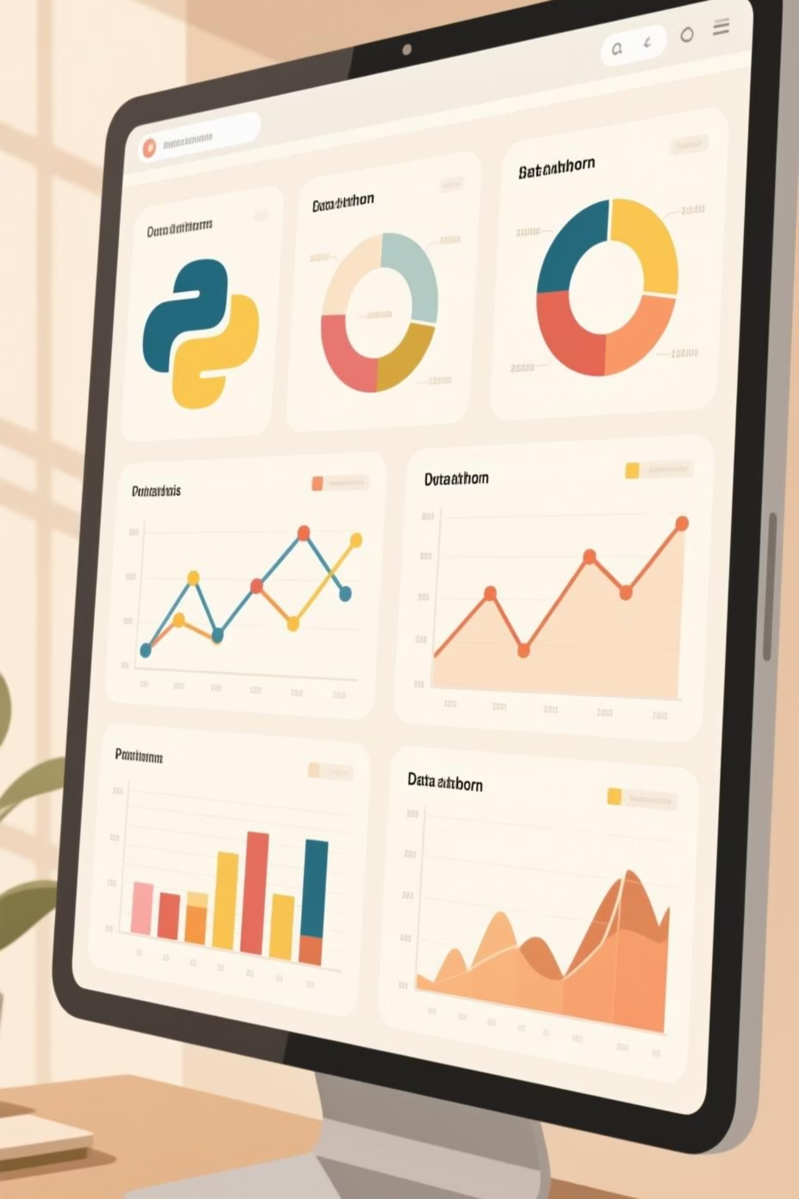
Exploratory Data Analysis Findings
Customer Demographics
Key Correlations
Most customers aged 25–40
Females spend more on clothing and accessories
Purchase amounts show right skew
Subscribed customers spend 15–20% more
Few high-value customers drive revenue
Fall and Spring have highest revenue

Slide 5

Revenue & Product Insights
Top 5 Products
Top Category
Gloves, Sandals, Boots, Hat, Skirts
Clothing leads revenue generation
Top Item
Pants most frequently purchased

Slide 6
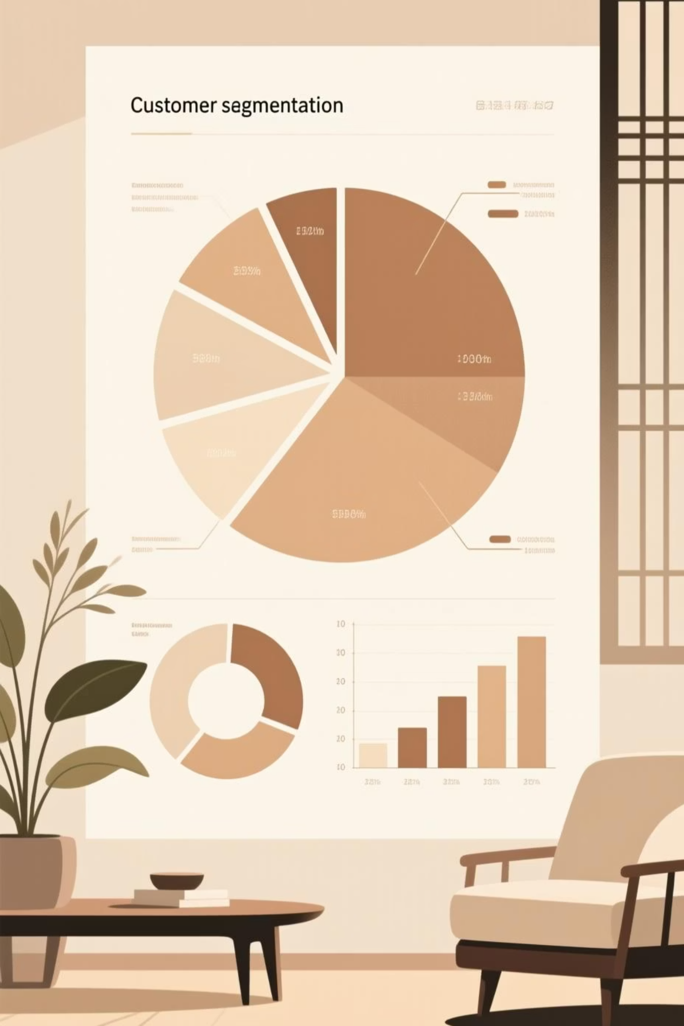
Customer Segmentation Analysis
Subscription Impact
Customer Lifecycle
Subscribed: 27% of customer base
Loyal customers represent the largest segment, followed by returning and new customers. Most repeat buyers are non-subscribers.
Non-subscribed: 73% of customer base
Subscribers show higher loyalty and spending patterns.

Slide 7





Payment & Shipping Preferences
Credit Card
PayPal
Dominant payment method
Second most popular
Free Shipping
Express Shipping
Customer preference
Highest performance

Slide 8
Strategic Recommendations
1
Boost Subscriptions
2
Seasonal Campaigns
Offer loyalty rewards and exclusive previews to increase adoption among high-value customers.
Focus marketing on Fall and Spring peaks. Run clearance offers during Summer to balance revenue.
3
Expand Top Categories
4
Enhance Experience
Introduce premium Clothing and Accessories lines. Cross-sell Footwear and Outerwear through recommendations.
Improve product quality, delivery speed, and return policies to boost satisfaction ratings.

Slide 9
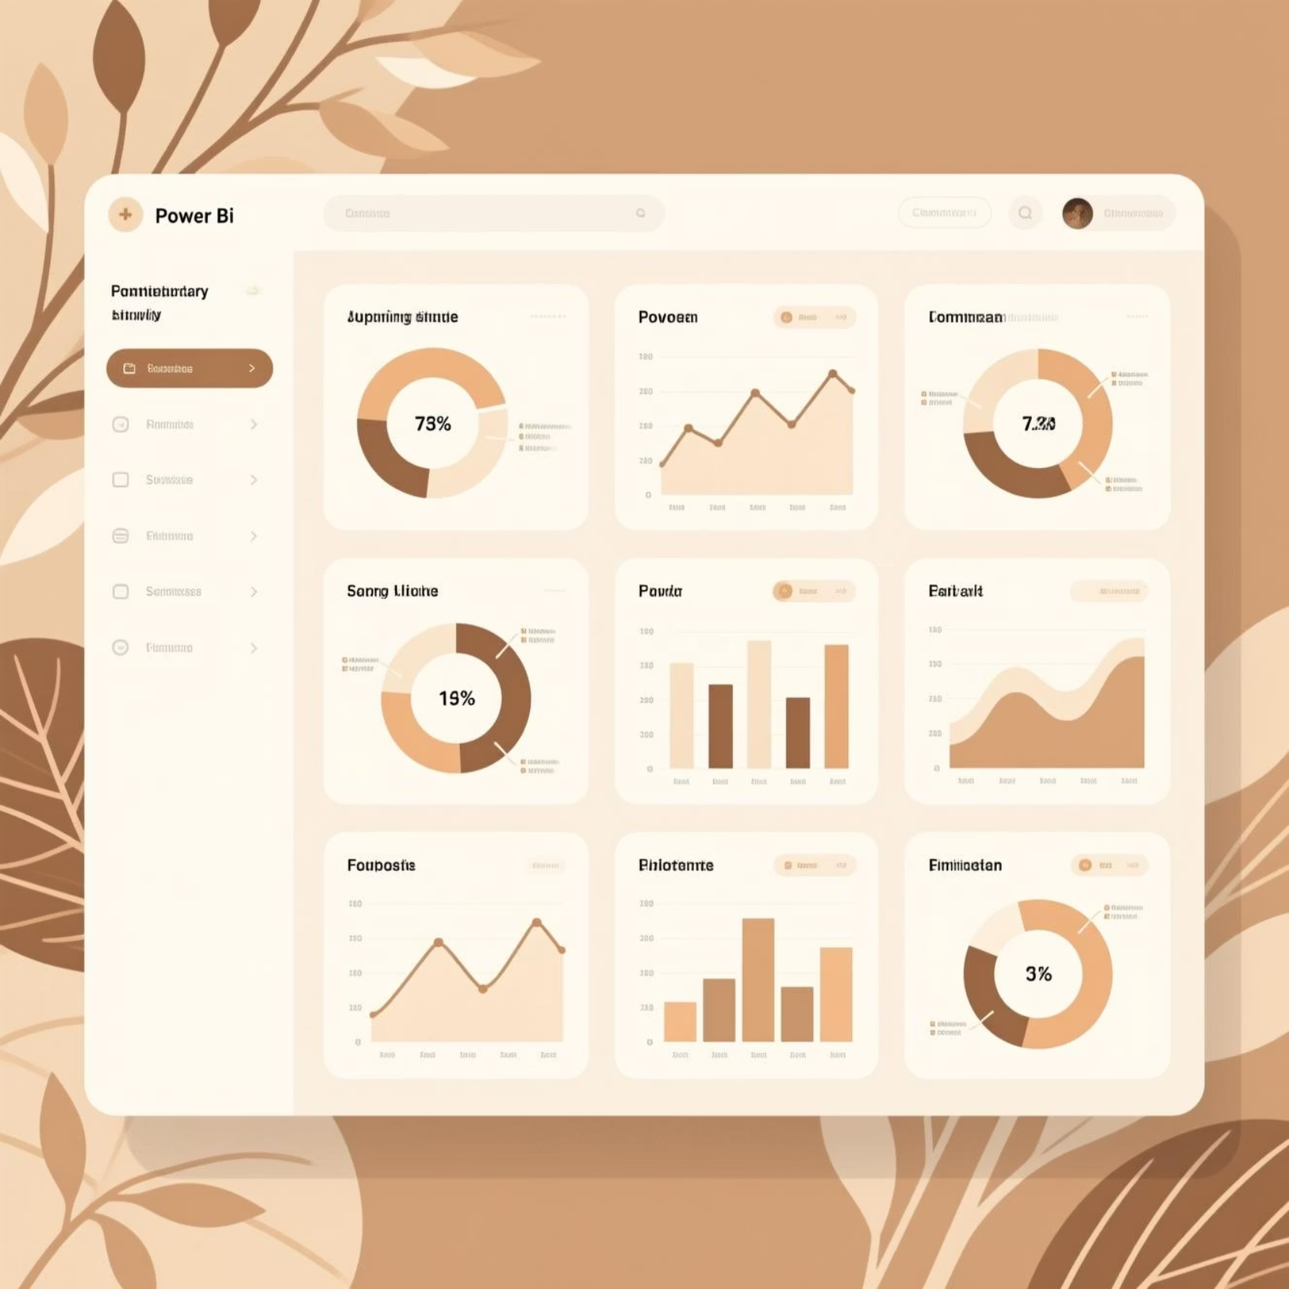
Power BI Dashboard Highlights
Visual Components
Revenue by Category
Revenue by Season
Sales by Category
Subscription Distribution
Payment Method Analysis
Gender-based Sales
Shipping Preferences

Slide 10

Conclusion
This data-driven analysis demonstrates how Python, SQL, and Power BI combine to unlock customer insights. By understanding shopping behavior across demographics, seasons, and preferences, the company can enhance loyalty, optimize marketing, and drive profitability through targeted strategies.

